Slide 1
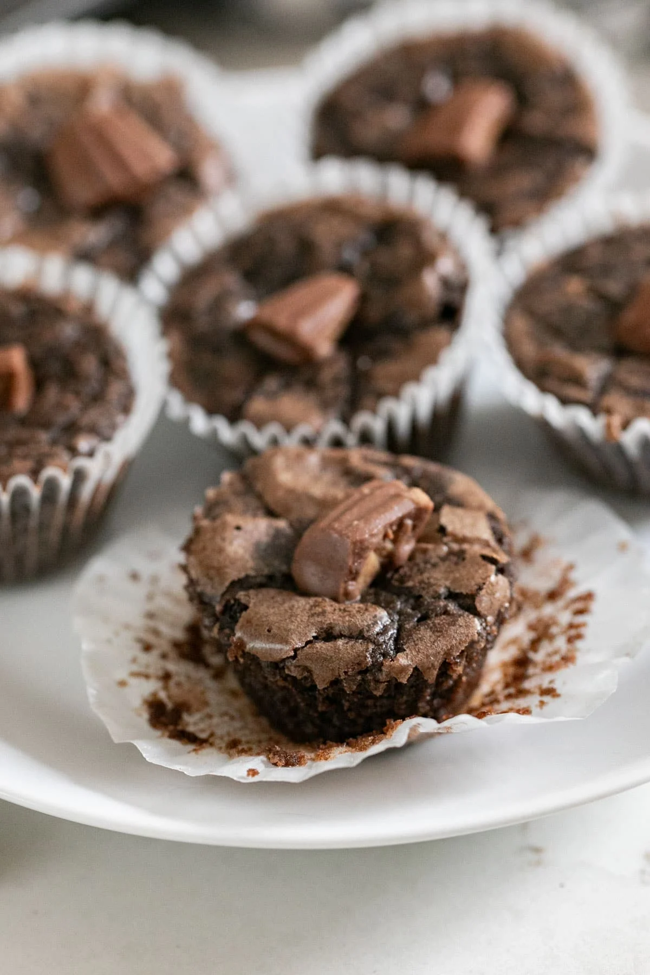
AGI Bazaar project product: Choco Bliss Mini Brownie Cups
Name : R.H.M. Janith Heshan Sampath
Student ID : 20258122

Slide 2
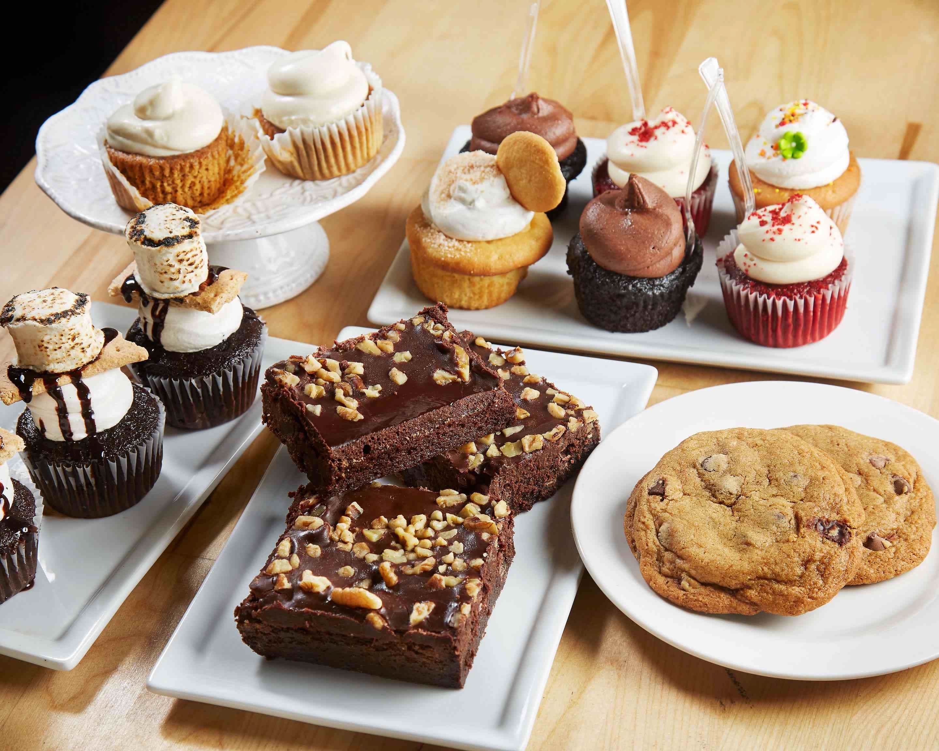
Content list
Idea generation
Survey summary
Market analysis
SWOT analysis
PEST analysis
Marketing mix
Action plan
Reflection summary
References

Slide 3
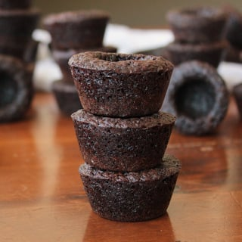
Idea generation
Product: Mini chocolate brownie cups
Designed for affordability and high student appeal
Easy to prepare in batches
Toppings to your liking: caramel, sprinkles, nuts, chocolate chips

Slide 4
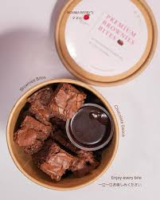
Survey summary
20 students surveyed
85% prefer chocolate-based snacks.
Ideal price range: $1.50–$2.00
60% of consumers prefer snacks for which toppings can be selected.
Students prefer grab-and-go treats

Slide 5
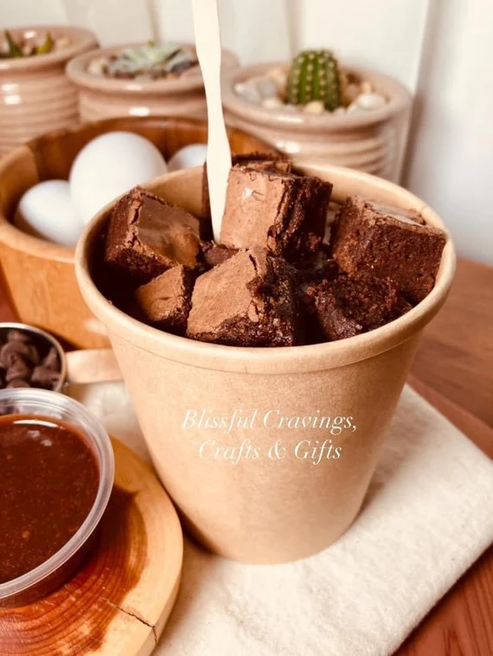
Market analysis
Competitors: Vending machines, cafés, other student booths
Gaps: Fresh, personalized desserts at very affordable prices
Our advantage: Fresh brownies, attractive presentation, affordable pricing

Slide 6
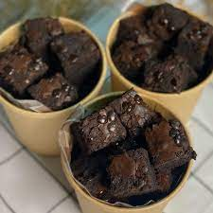
SWOT analysis
Strengths: Fresh, customizable, affordable
Disadvantages: Short storage life, preparation needed
Opportunities: high demand among students, social media promotion
Threats: Competing dessert booths, low student spending

Slide 7
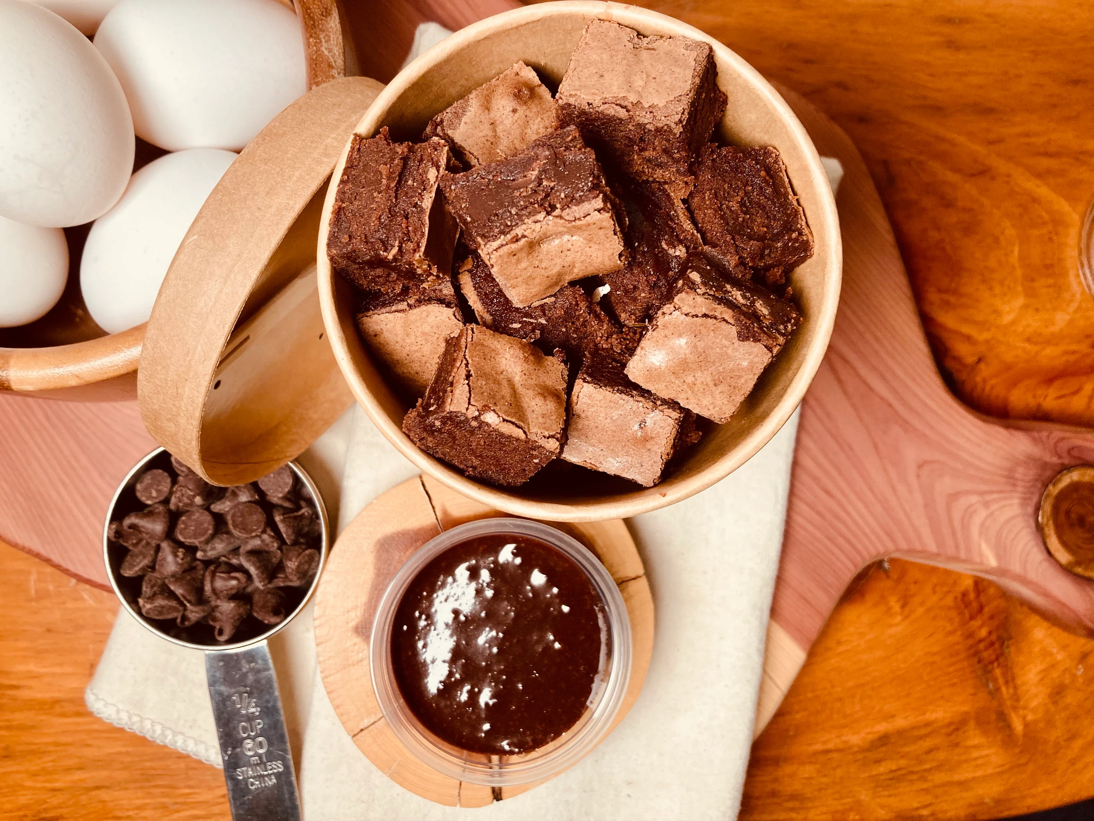
PEST analysis
Political: Campus allowed safe food sales
Economic: students prefer inexpensive snacks
Social: Chocolate enjoys widespread popularity.
Technological: Easy social media promotions via posters and videos

Slide 8

Marketing mix
Product: Mini brownie cups, topped with your choice
Price:
$2 per cup
A bundle deal: 3 cups for $5
Place: AGI Bazaar booth with decorated setup
Promotion
Digital posters
Instagram and WhatsApp sharing
Live calls & topping display at booth

Slide 9
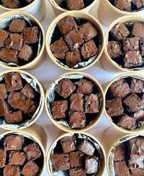
Action plan
Ingredient purchase & recipe testing – Week 1
Survey & analysis – Week 1
Poster design & promotion – Week 2
Brownie production – Event day
Booth setup & sales tracking – Event day Budget: $80 total

Slide 10

Reflection summary
Improved teamwork and decision-making
Applied marketing concepts: survey, SWOT, 4Ps
Gained hands-on entrepreneurial experience
Contributed to charity through bazaar profits

Slide 11
References
Companies, T. M.-H., 2025. DEVELOPING NEW PRODUCTS AND SERVICES. [Online] Available at: https://personal.utdallas.edu/~nkumar/CHPT11.PDF
Cooper, R., 2025. Developing New Products On Time, In Time. [Online]
Available at: https://www.researchgate.net/publication/284697854_Developing_New_Products_On_Time_In_Time
Courseware, 2025. DEVELOPING NEW PRODUCT. [Online]
Available at: https://courseware.cutm.ac.in/wp-content/uploads/2020/06/New-Product-Development.pdf
Pereira, C. H., 2018. New product development in small and medium-sized technology based companies: a multiple case study. [Online]
Available at: https://www.redalyc.org/journal/3032/303258327046/303258327046.pdf
Yankosh, 2025. EW PRODUCT DEVELOPMENT AND PRODUCT LIFE CYCLE. [Online]
Available at: https://egyankosh.ac.in/bitstream/123456789/14836/1/Unit-6.pdf

Slide 12
Thank you

